Slide 1

Module 6 – Video 2
First-Degree Price Discrimination
Professor Nico Voigtländer
Management 405: Module 6

Slide 2
OUTLINE of module 6
Simple vs. complex pricing
Direct price discrimination
  Perfect price discrimination (first degree)
  Segment pricing (third degree)
Indirect price discrimination (second degree)
  Versioning
  Coupons
Advanced pricing strategies
  Volume pricing with flat fee
  Two-part tariff
  Block pricing

Slide 3
First degree price discrimination
Charge each customer a different price
Also known as perfect price discrimination
Conditions:
  Many consumers with different MPV for the firm’s product
  Firm knows each consumer’s MPV (i.e., willingness to pay)
  Firm can prevent resale
Note: This is a hypothetical scenario!

Slide 4
First degree price discrimination
Price / MPV
Assume MC=0
Charge each customer a different price
The Holy Grail of complex pricing
Zero consumer surplus: everything is extracted!
Price charged to
high-MPV customer
Price charged to
median-MPV customer
Revenues and Profits
(assume MC=0)
Price charged to
low-MPV customer
Demand = MPV
Notes:
In an ideal world you would like to charge individual prices to mop up all the surplus – to capture all the area beneath the Demand curve in the form of corporate revenue. This type of customized pricing represents the ideal. Customized to what? To the buyers’ valuations! This is difficult to do in practice for a variety of reasons: e.g., arbitrage, legal restrictions.

Slide 5
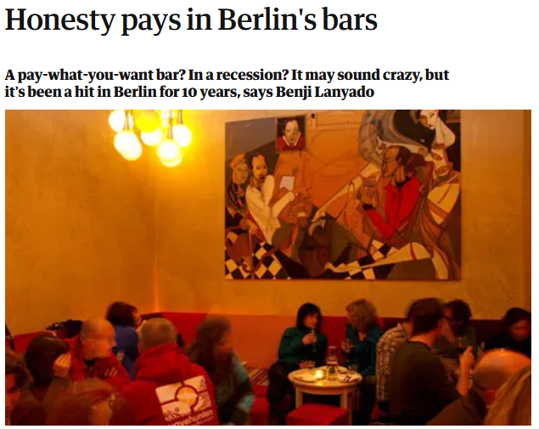

First degree price discrimination
Price / MPV
Now: MC>0
Can it work in the real world?
Price charged to
high-MPV customer
Price charged to
median-MPV customer
Profits (if TFC=0)
Do not sell to low-MPV customer
MC
Demand = MPV
Notes:
In an ideal world you would like to charge individual prices to mop up all the surplus – to capture all the area beneath the Demand curve in the form of corporate revenue. This type of customized pricing represents the ideal. Customized to what? To the buyers’ valuations! This is difficult to do in practice for a variety of reasons: e.g., arbitrage, legal restrictions.

Slide 6
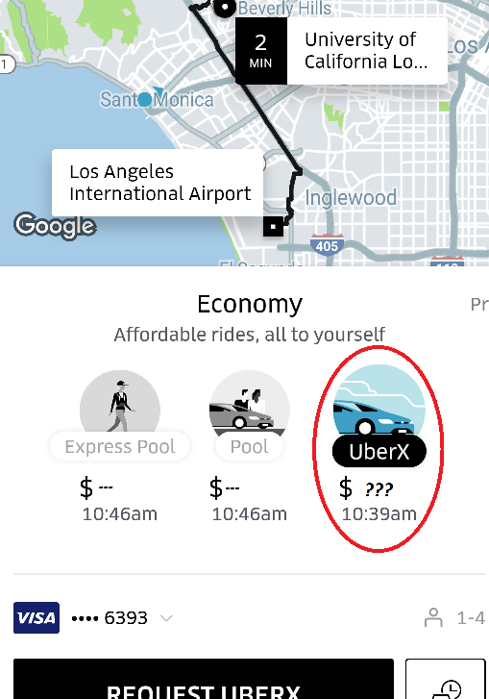
The Dystopian Future of Price Discrimination
By tracking consumer behavior, (tech) companies are increasingly able to use first degree price discrimination (personally tailored prices)
Example: Uber

